Slide 1

Restaurant Business Ranking 2020
Reviewed By: Andrew Woodruff

Slide 2
Restaurant Business Ranking 2020
Data set pulled from Kaggle:
https://www.kaggle.com/michau96/restaurant-business-rankings-2020
Data set contained three files:
Future50 –
Independence100 –
Top250 -
Sdf
Asdf
Lets take a look at what the data can tell us.

Slide 3
Top 250 Breakdown
Top 5 Sales in 2019
McDonald’s
Starbucks
Chick-fil-A
Taco Bell
Burger King
SELECT Restaurant,
Sales
FROM Top250
ORDER BY Sales DESC
LIMIT 5;
Top 5 Sales Growth
Café Rio Mexican Grill
Jack’s
Mastro’s Restaurants
Nobu
Taco Bell
SELECT Restaurant,
YOY_Sales
FROM Top250
ORDER BY YOY_Sales DESC
LIMIT 5;
Top 5 Sales per Store
Mastro’s Restaurants
Del Frisco’s Double Eagle Steak House
Grand Lux Cafe
The Cheesecake Factory
Ocean Prime
SELECT Restaurant,
Sales / Units AS [Sales per Store]
FROM Top250
ORDER BY [Sales per Store] DESC
LIMIT 5;

Slide 4
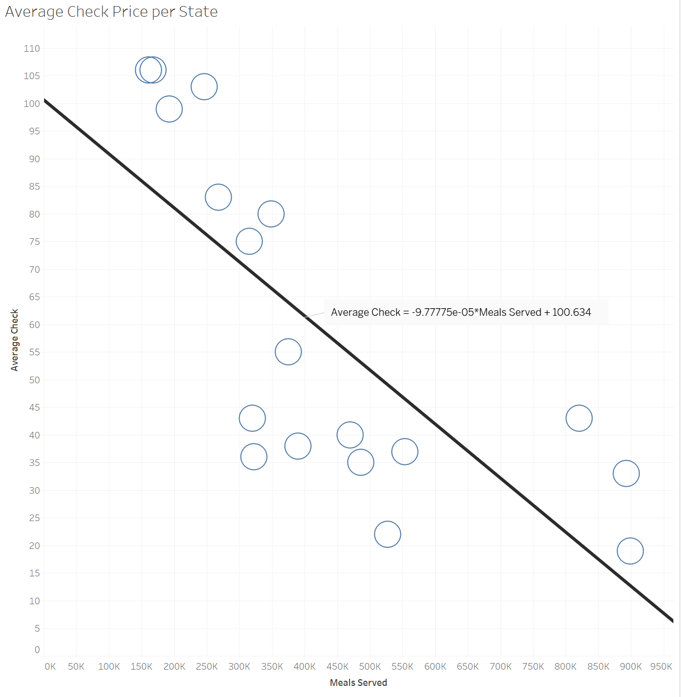
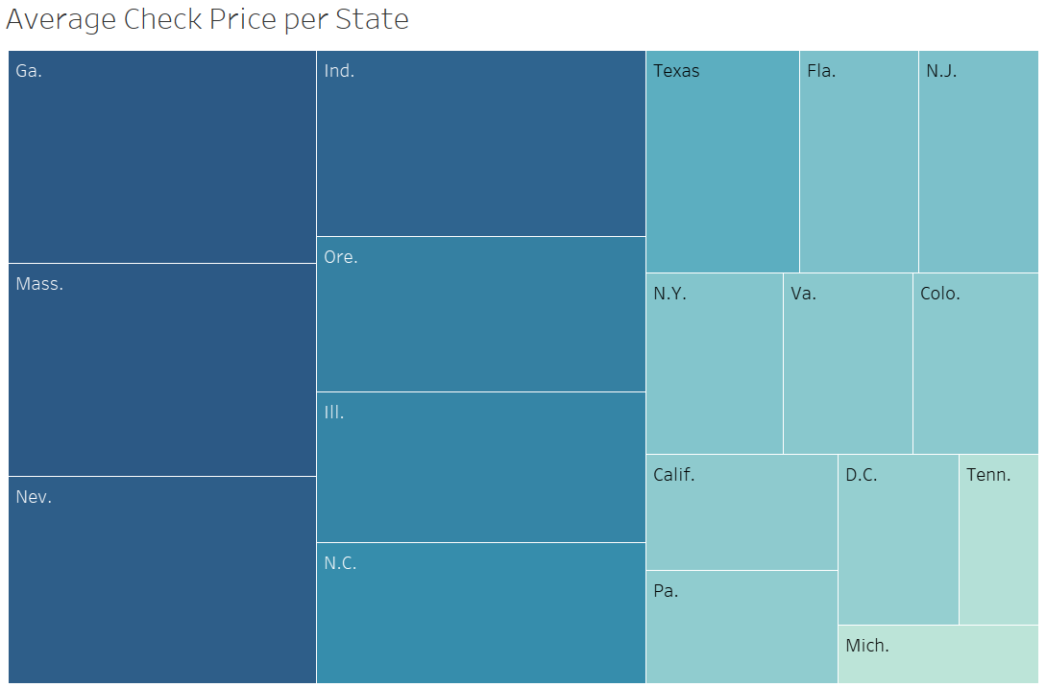
Independence 100 Breakdown

